Slide 1
Deep Learning Artificial Neural Networks
By Daniel Oliveira

Slide 2
What is a Perceptron?
It is the simplest form of neural network
Made for binary classification
It is a linear classifier
A multi-layer perceptron is called a neural network (more on that later)

Slide 3
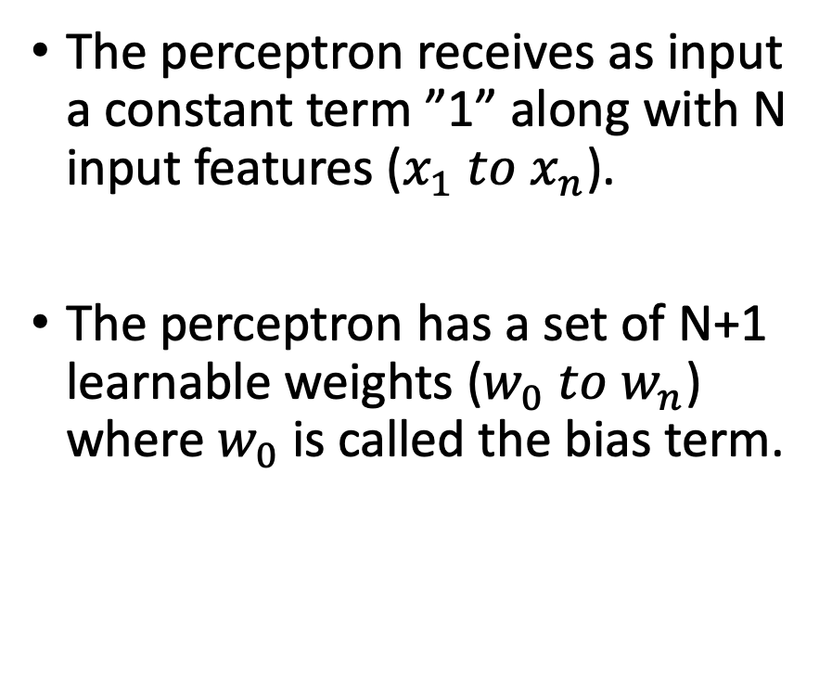
Perceptron
The perceptron receives as input a constant term ”1” along with N input features ($x_{1} to x_{n}$).
The perceptron has a set of N+1 learnable weights ($w_{0} to w_{n}$) where $w_{0}$ is called the bias term.
Image taken from: towardsdatascience.com

Slide 4
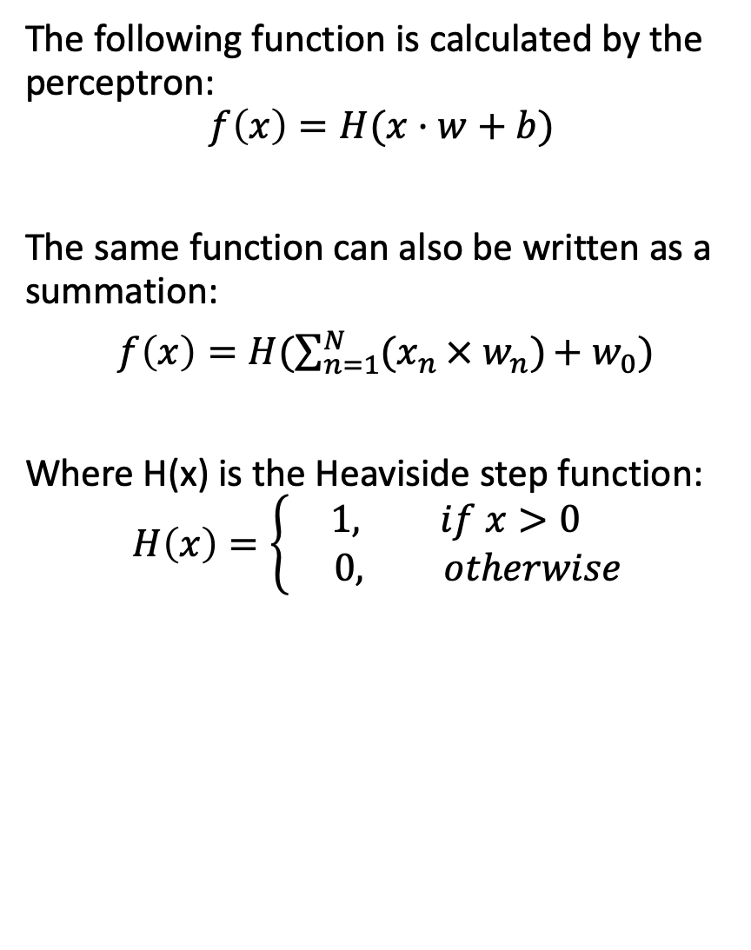
Perceptron
The following function is calculated by the perceptron:
$$f\left(x\right)=H(x·w+b)$$
The same function can also be written as a summation:
$f\left(x\right)=H(\sum_{n=1}^{N}{{(x}_{n }× w_{n})}+{ w}_{0})$
Where H(x) is the Heaviside step function:
$$H\left(x\right)=\left\{\begin{aligned}1, if x>0 \\ 0, otherwise\end{aligned}\right.$$
Image taken from: towardsdatascience.com

Slide 5
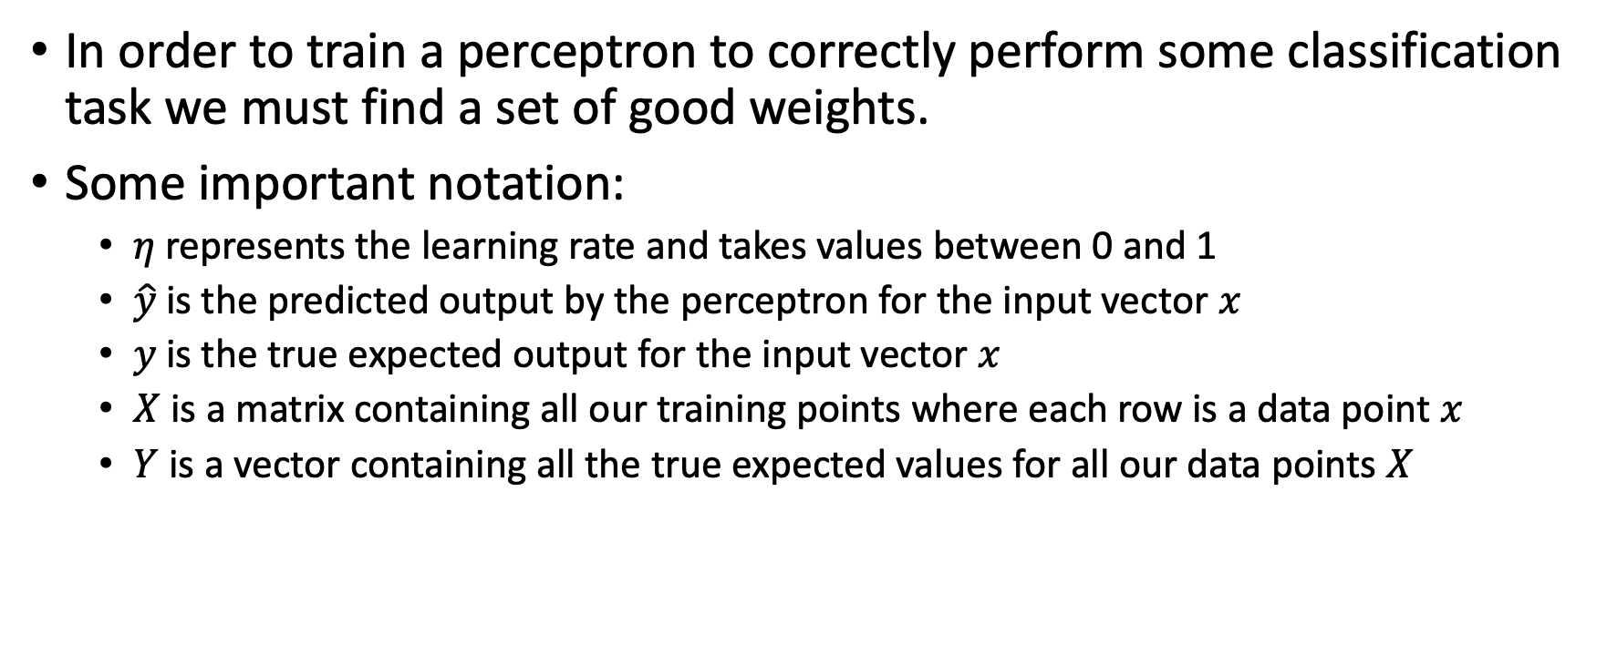
Perceptron learning rule
In order to train a perceptron to correctly perform some classification task we must find a set of good weights.
Some important notation:
$η$ represents the learning rate and takes values between 0 and 1
$\hat{y}$ is the predicted output by the perceptron for the input vector $x$
$y$ is the true expected output for the input vector $x$
$X$ is a matrix containing all our training points where each row is a data point $x$
$Y$ is a vector containing all the true expected values for all our data points $X$

Slide 6
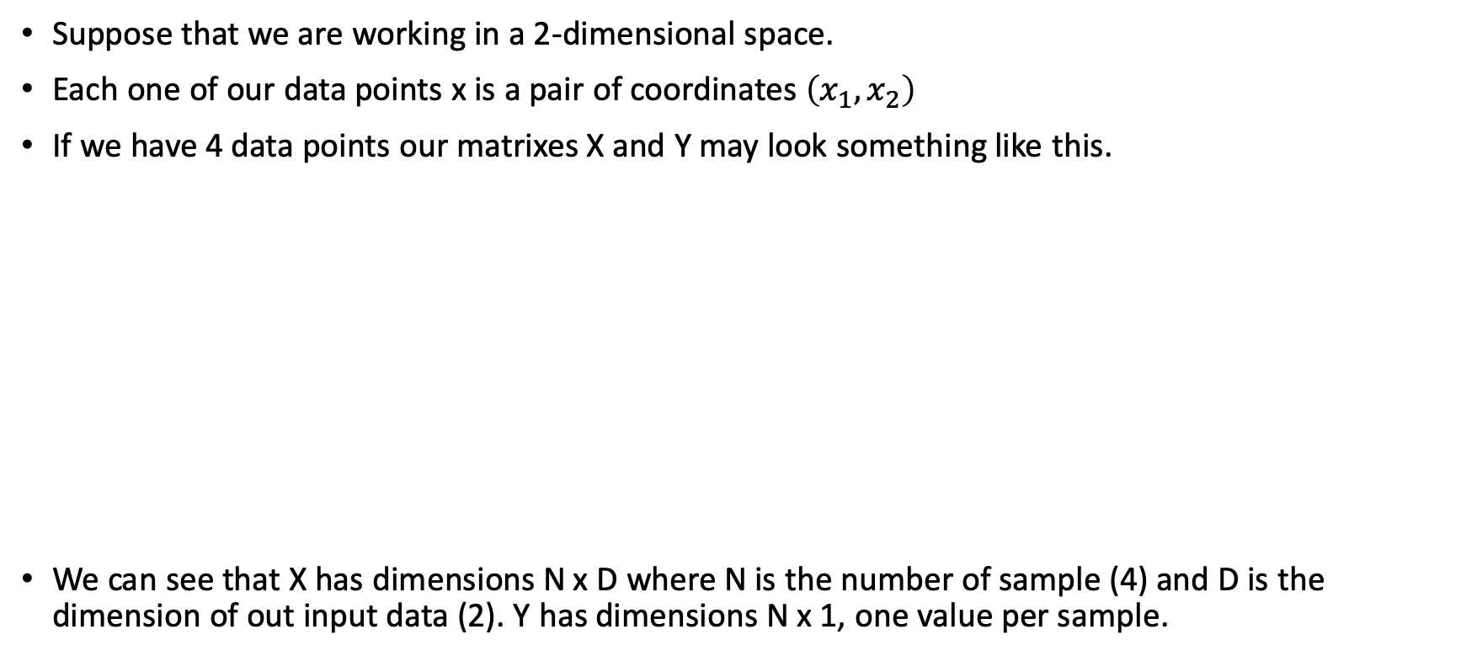
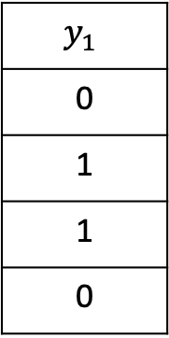
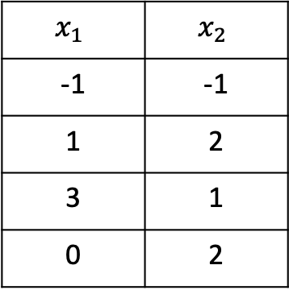
Perceptron learning rule
Suppose that we are working in a 2-dimensional space.
Each one of our data points x is a pair of coordinates $\left(x_{1}, x_{2}\right)$
If we have 4 data points our matrixes X and Y may look something like this.
We can see that X has dimensions N x D where N is the number of sample (4) and D is the dimension of out input data (2). Y has dimensions N x 1, one value per sample.
$$x_{1}$$ | $$x_{2}$$
-1 | -1
1 | 2
3 | 1
0 | 2
$$y_{1}$$
0
1
1
0
X =
Y =

Slide 7
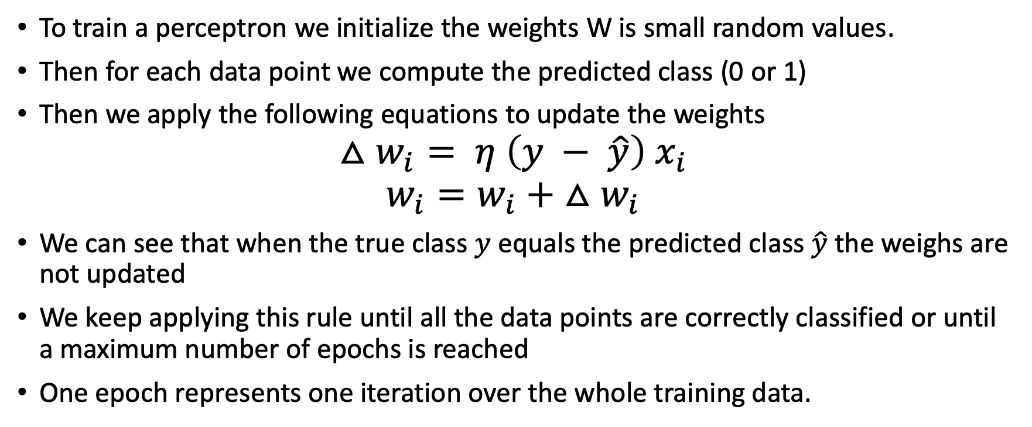
Perceptron learning rule
To train a perceptron we initialize the weights W is small random values.
Then for each data point we compute the predicted class (0 or 1)
Then we apply the following equations to update the weights
$$△w_{i}= η \left(y − \hat{y}\right) x_{i}$$
$$w_{i}=w_{i}+ △w_{i}$$
We can see that when the true class $y$ equals the predicted class $\hat{y}$ the weighs are not updated
We keep applying this rule until all the data points are correctly classified or until a maximum number of epochs is reached
One epoch represents one iteration over the whole training data.

Slide 8
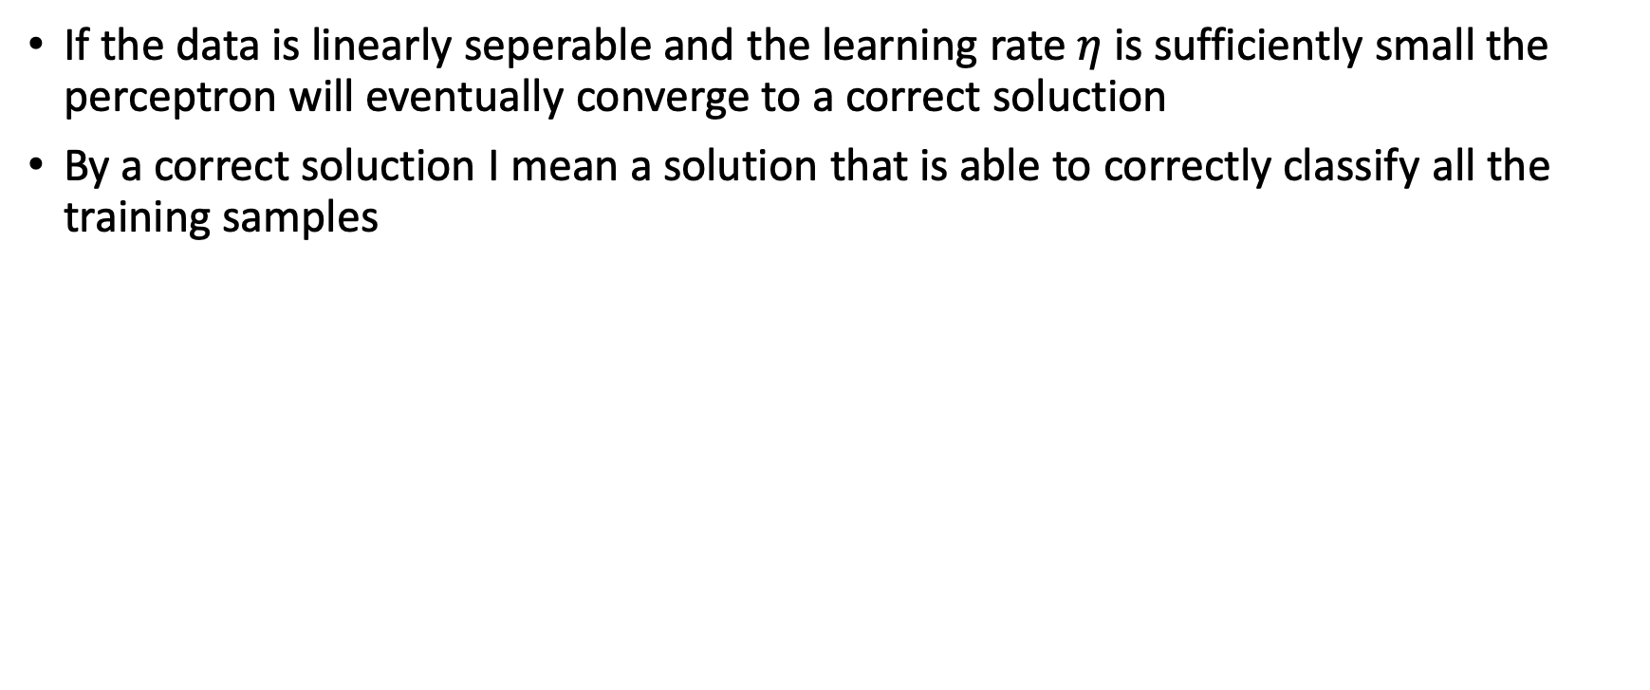
Perceptron learning rule
If the data is linearly seperable and the learning rate $η$ is sufficiently small the perceptron will eventually converge to a correct soluction
By a correct soluction I mean a solution that is able to correctly classify all the training samples

Slide 9
Linearly seperable data
Linearly seperable data is all the data that can be seperable by an hyperplane (a rect in two dimensions).
Linearly seperable
Non-linearly seperable
Image taken from: tarekatwan.com

